Slide 1
FRONT END PROJECT
THE Z.COM
INSTRUCTOR:MR.LOVISH ARORA
Anshuman Sharma
2110990222
G5

Slide 2

Table of contents
01
02
03
04
05
06
Introduction
Why Choose Us?
Goals
Challenges
Screenshots
Future Scope

Slide 3

Introduction
THEZ.COM is not just another e-commerce platform; it's a groundbreaking revolution in the online shopping sphere. In a world that's rapidly embracing the digital realm, THEZ.COM stands as your ultimate destination for an unparalleled shopping adventure. We pride ourselves on being more than just a marketplace; we're a gateway to a world where limitless possibilities converge with your deepest desires.
Embrace the Future of Shopping with THEZ.COM.

Slide 4

WHY THEZ
The" gives presence to the topic. It gives specific attention”.
Z in Electrical terms is called impedance that means Opposition to flow of current. If you take others as flow then we are here to revolutionize and change the flow in our favor.

Slide 5

Why Choose Us?
Why should you choose THEZ.COM over other e-commerce websites? Here are a few reasons why you'll love shopping with us:
Quality Assurance
Easy Navigation
Fast and Reliable Shipping
Exceptional Customer Service

Slide 6

Goals
Increase sales and Revenue
Expand Customer Base
Improve Customer Retention
Enhance User Experience
Utilize Data for Insights

Slide 7

Challenges:
Finding relevant stuff
Making Fully-Functional Shopping cart
Peformance Enhancing
Content Presentation
Choosing colours

Slide 8
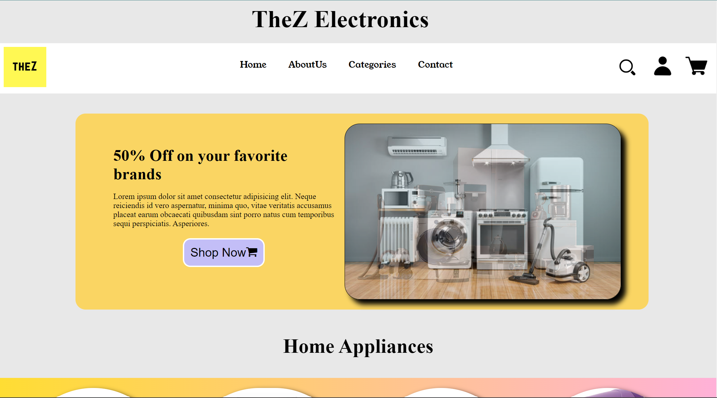
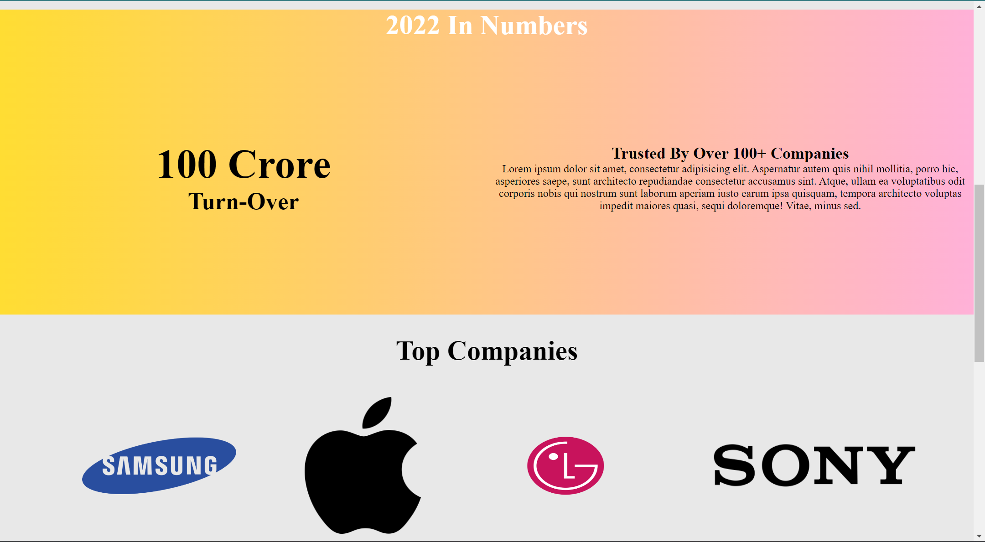
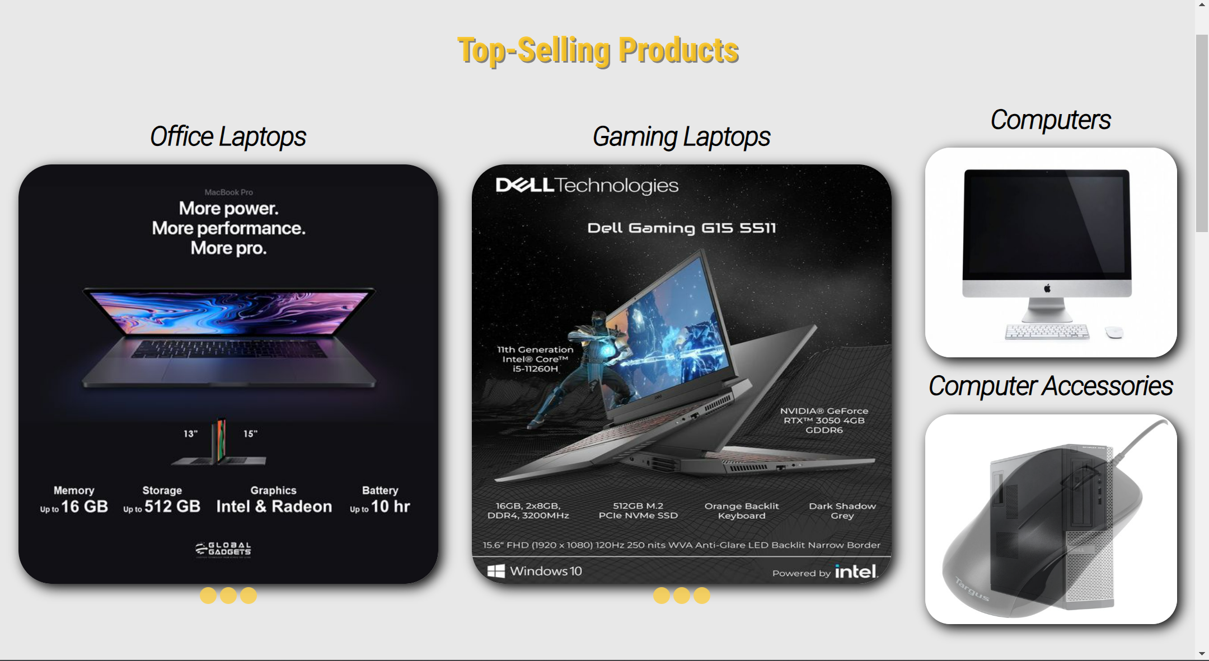
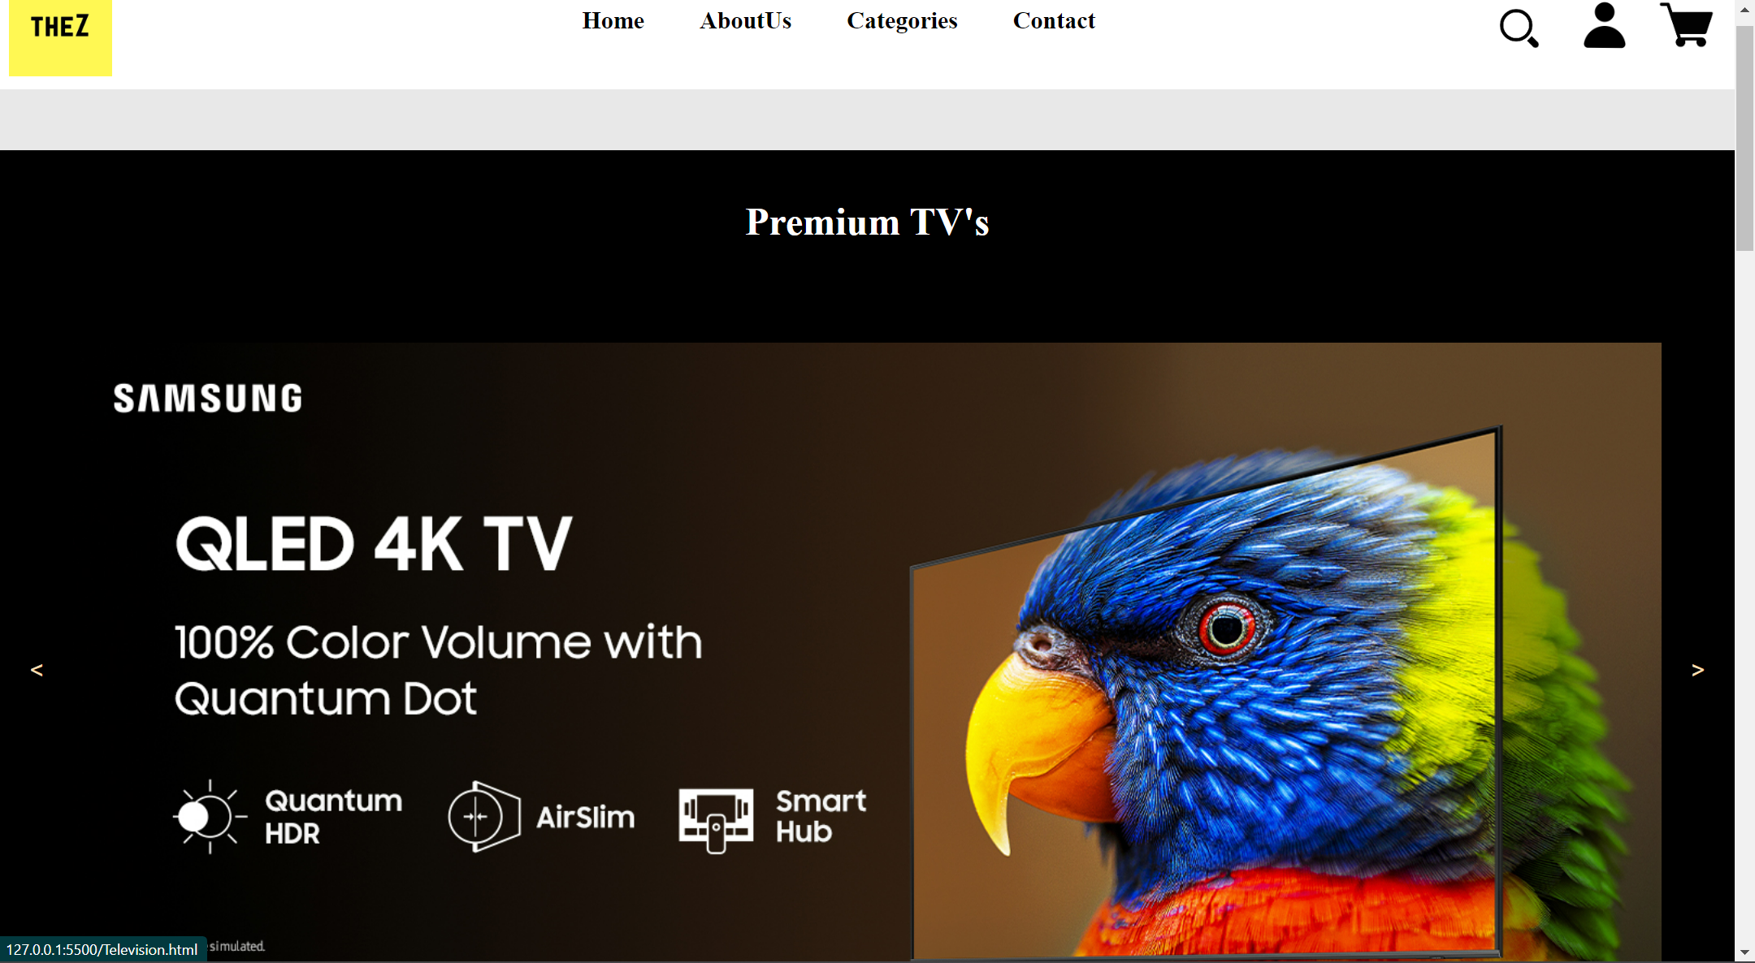
ScreenShots

Slide 9

Future Plans:
Enhancing User Experience
Expanding Business
Making Mobile App
Attracting Customers

Slide 10
Thank You

